Slide 1
DPS Progress Report 2
Elizabeth, Greg, Ray, Phillip, Spencer

Slide 2
Data Dictionary
DM - Dungeon master - Controls what happens in the game
Character sheet - Sheet that has character stats
NPC - Non-player character usually controlled by the DM
Game log - Textbox that displays in game information

Slide 3
Overall Systems
Map
Creation
Editing
Connectivity
Share Map & Game Log
Update Shared Assets
UI
Database & Connector
Load Assets
Save Assets
Quality of Life
Character Sheets
Dice Roller
Game Log

Slide 4
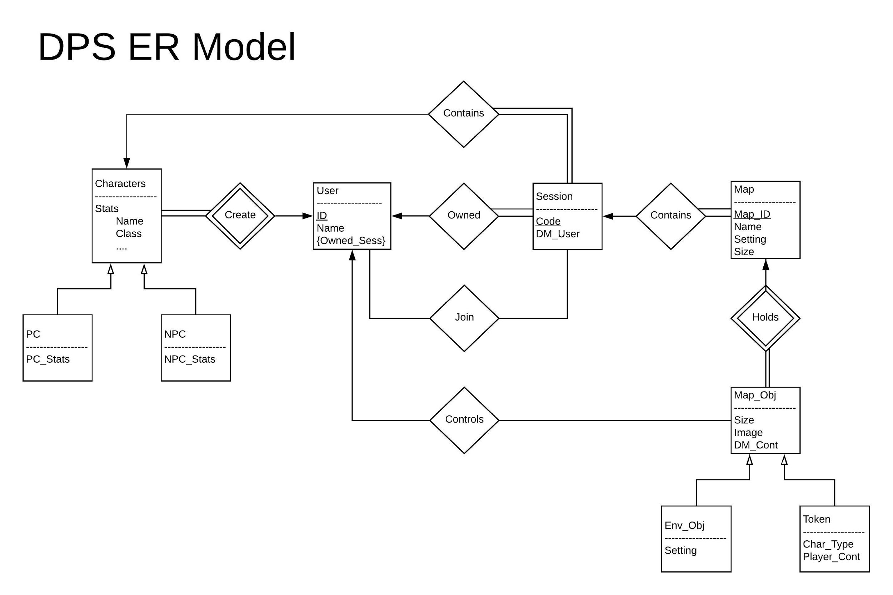

Slide 5
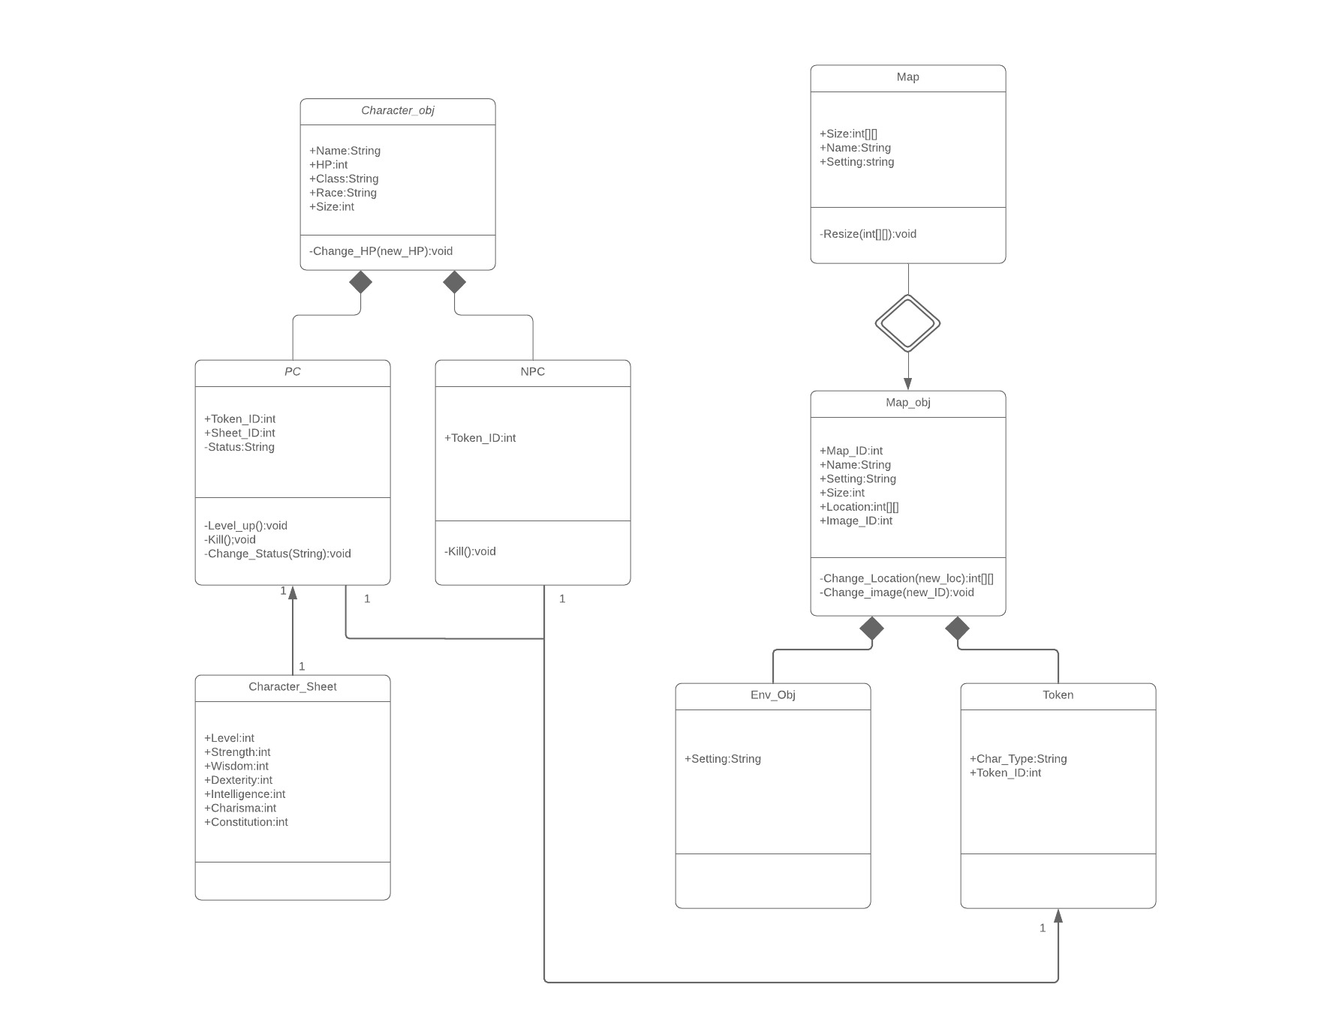
UML Chart

Slide 6
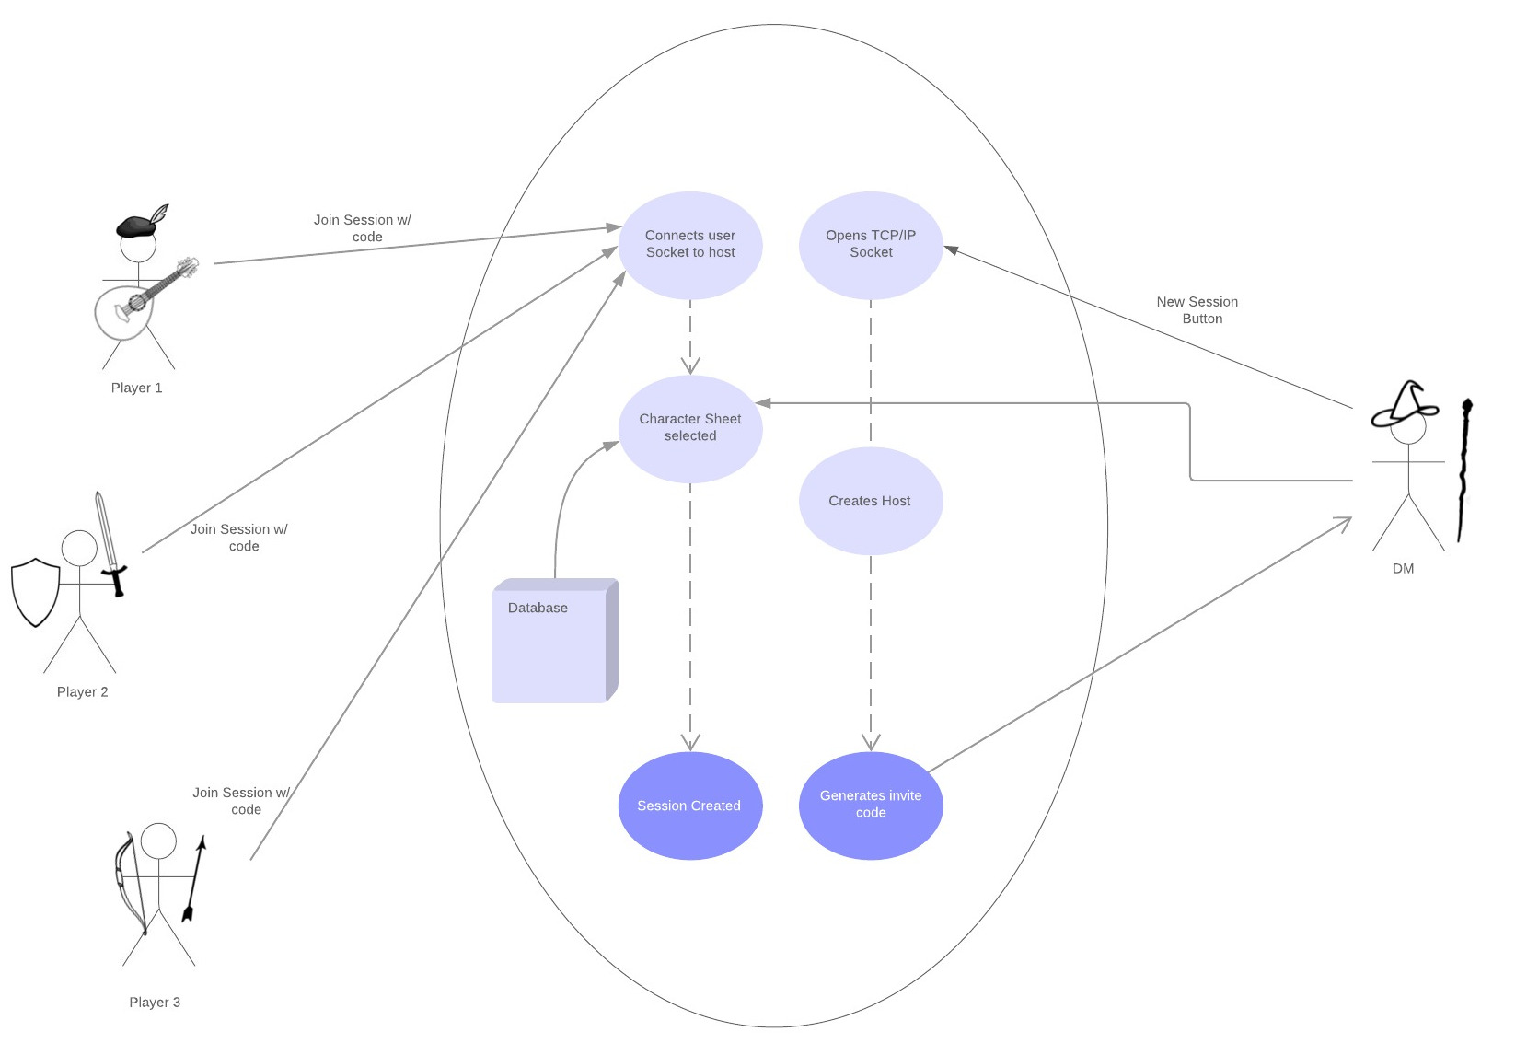
Use Cases
Making a new session

Slide 7
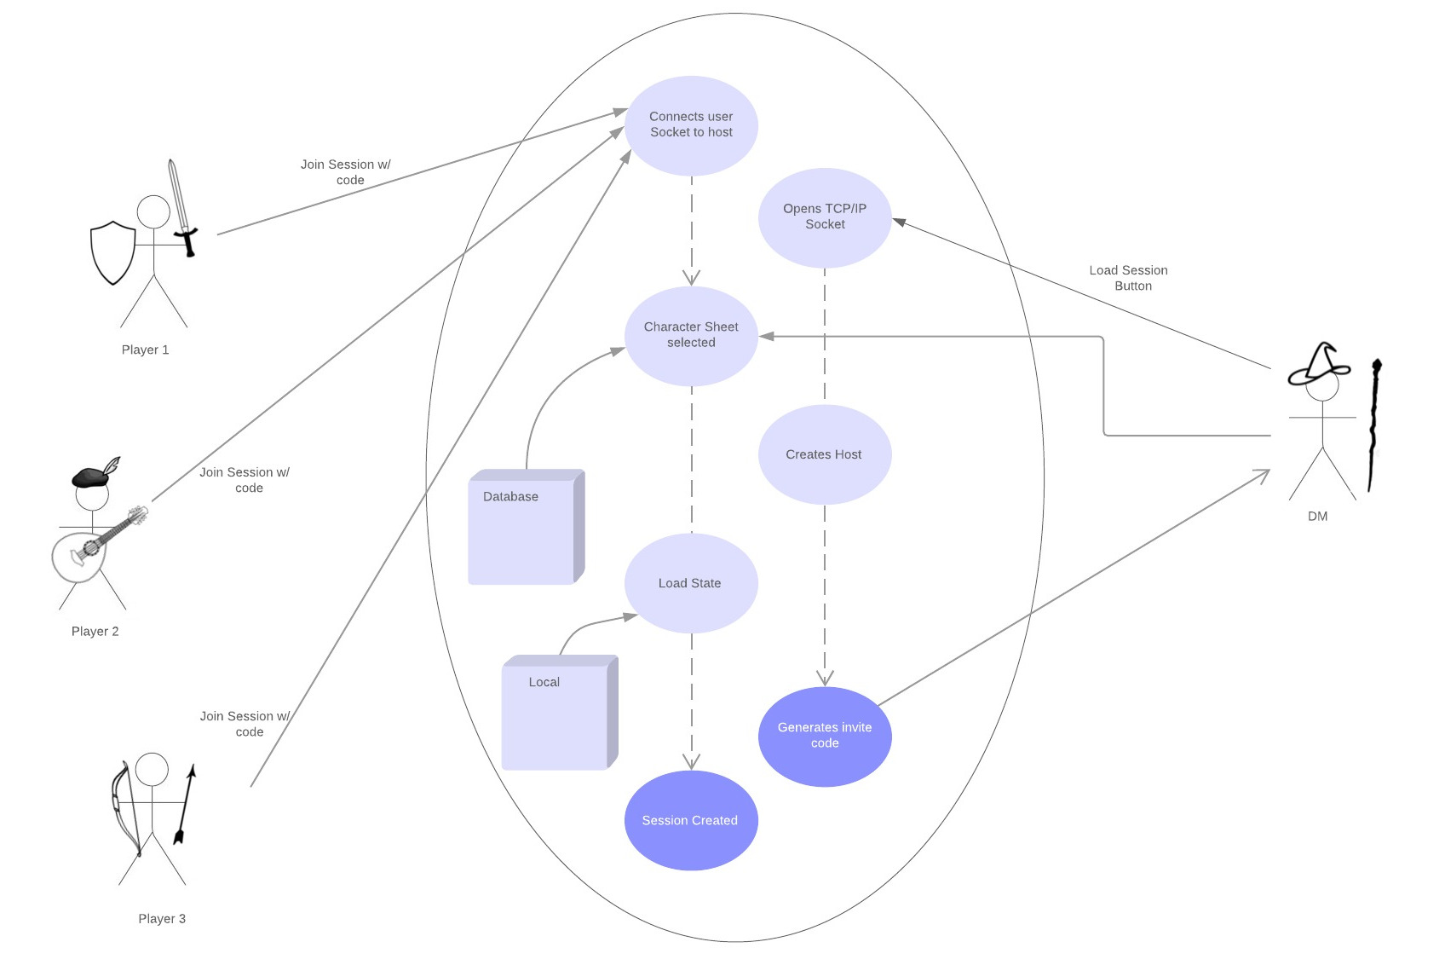
Use Cases
Loading a session

Slide 8
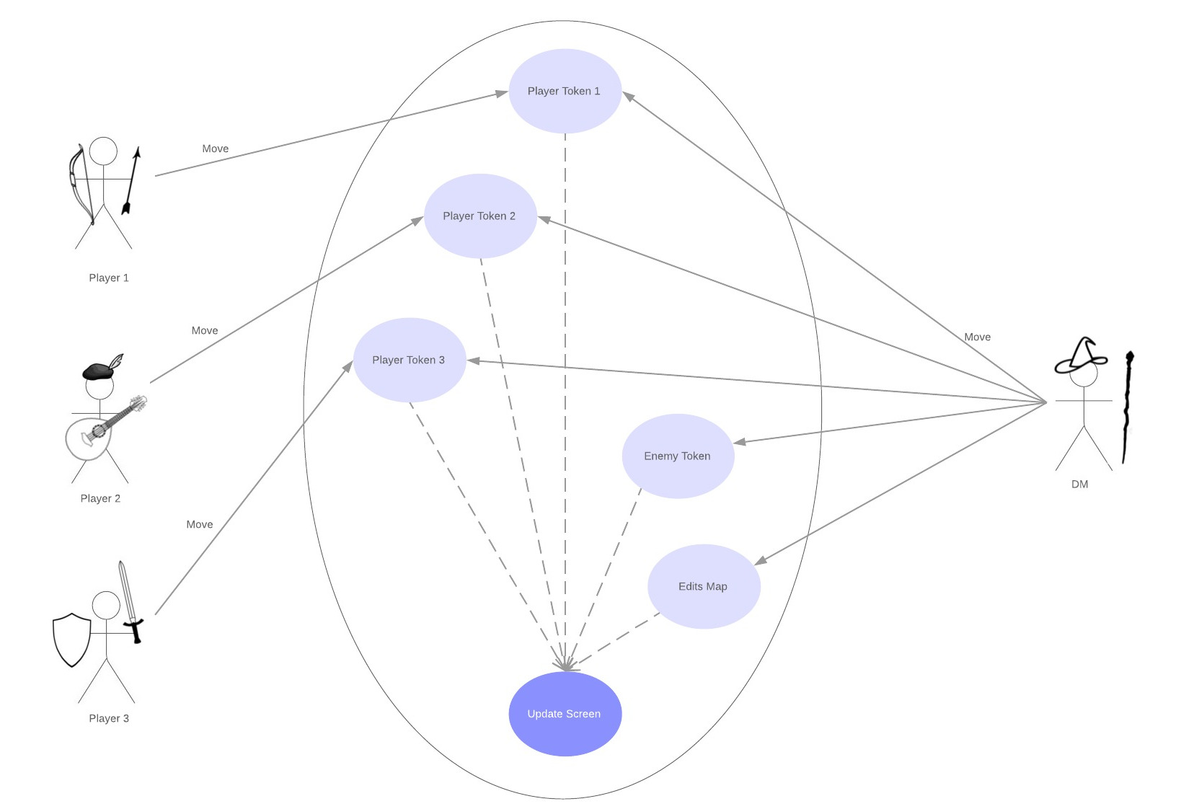
Use Cases
Playing

Slide 9
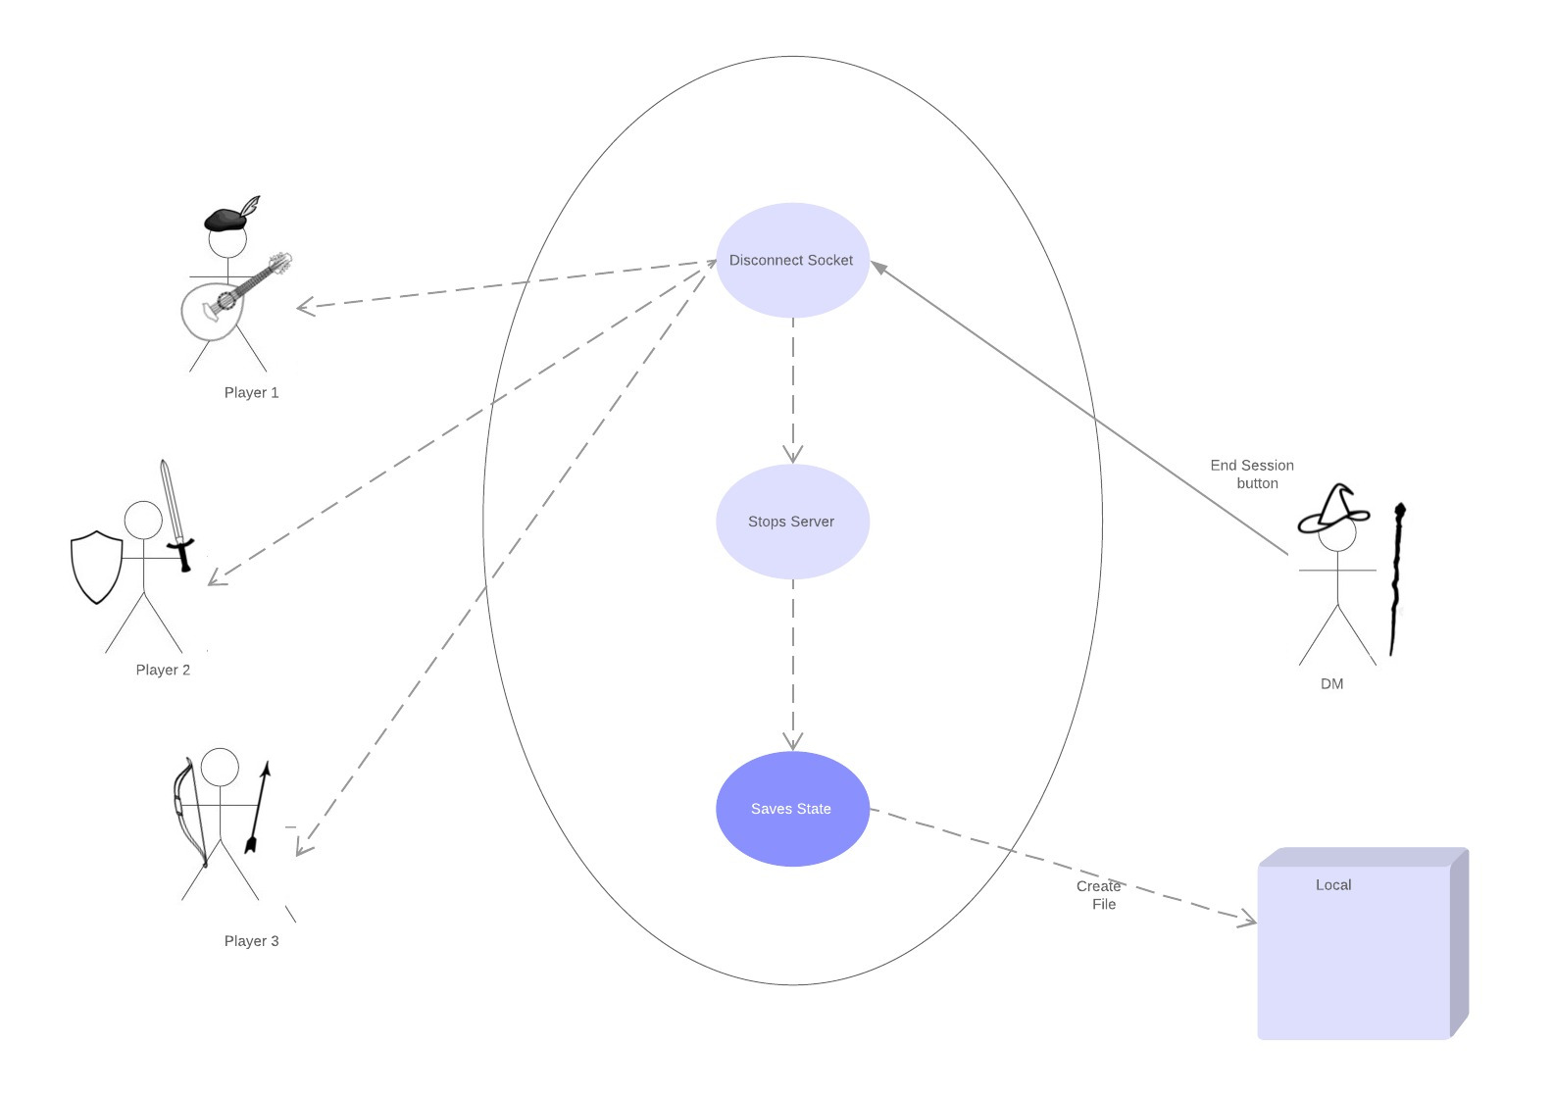
Use Cases
End Session

Slide 10
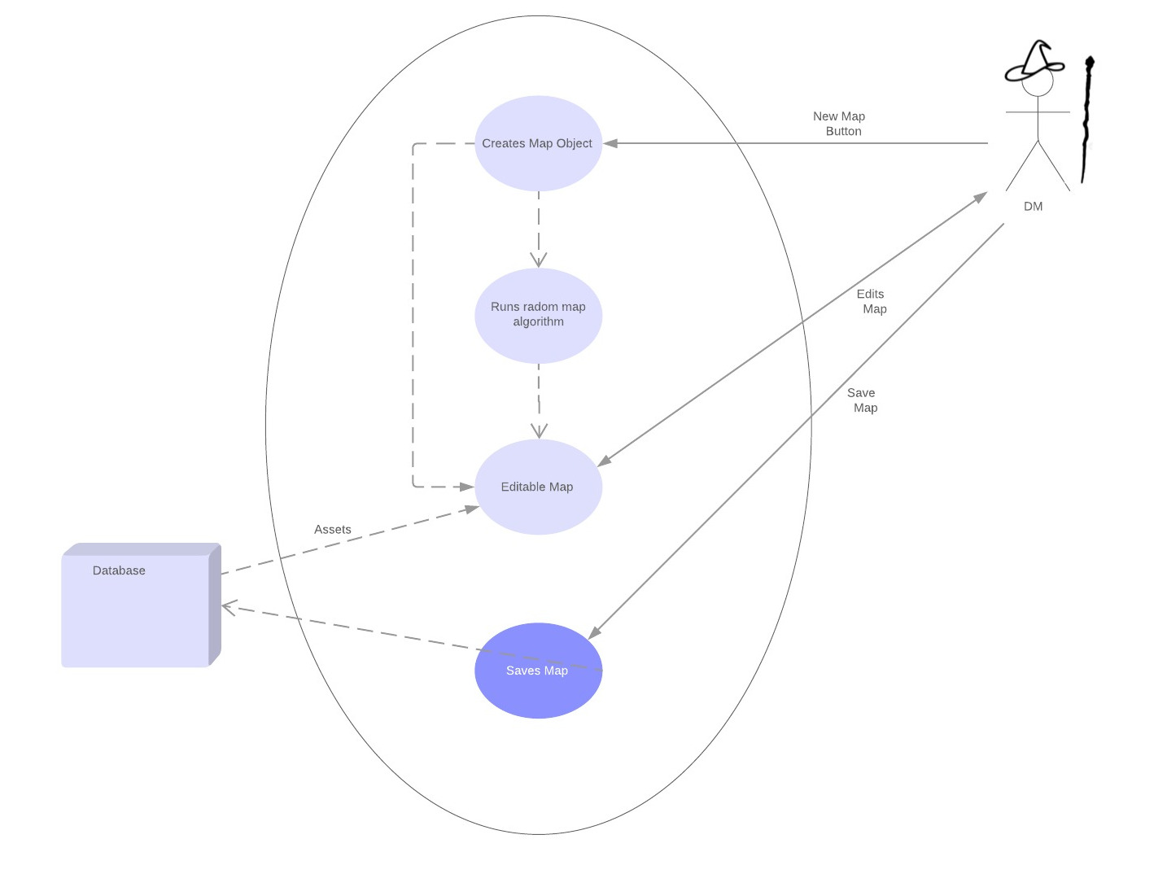
Use Cases
Making a map

Slide 11
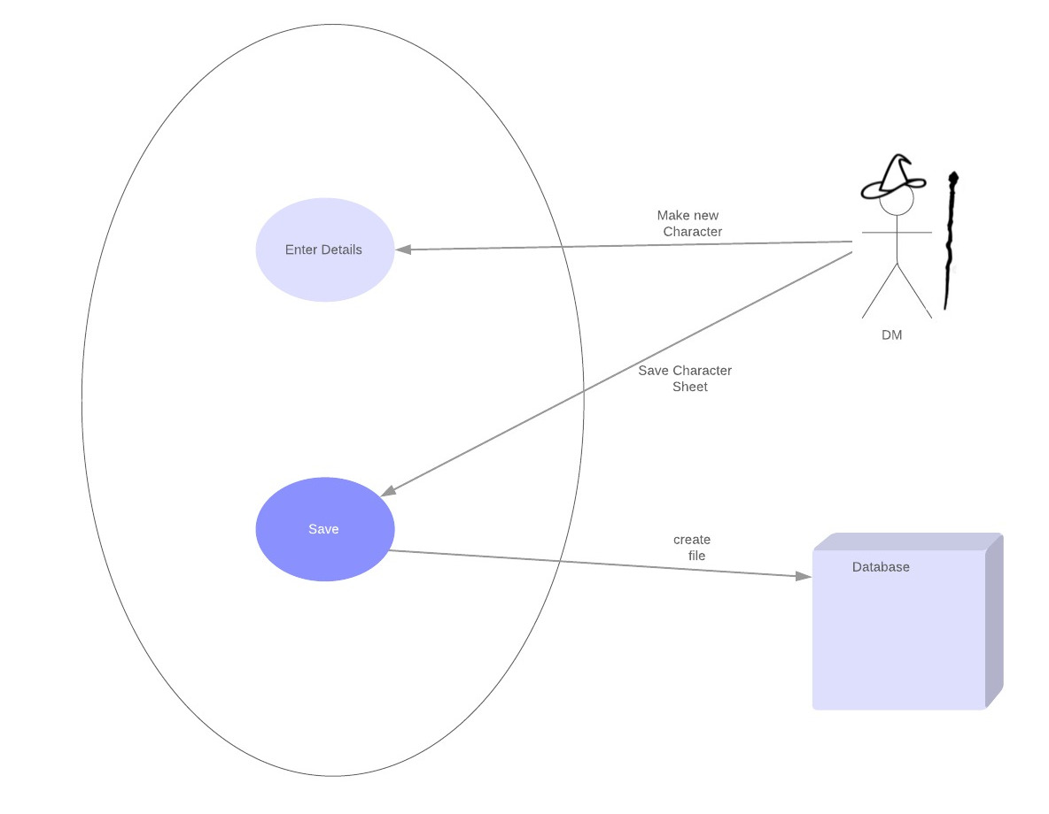
Use Cases
Making a character

Slide 12
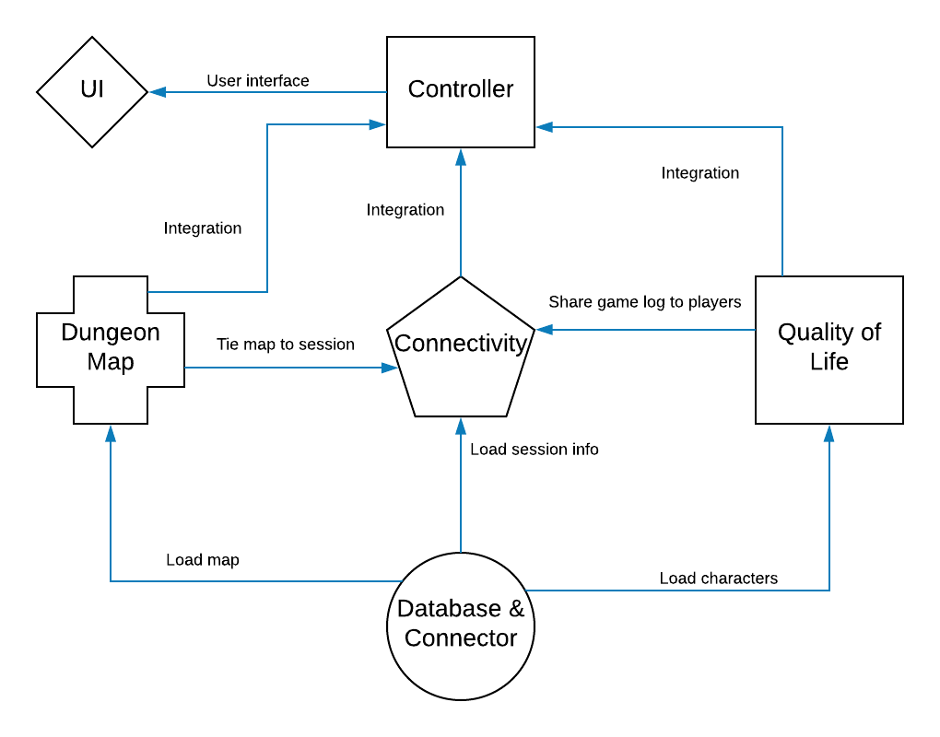
Subsystem Communication
Inputs

Slide 13
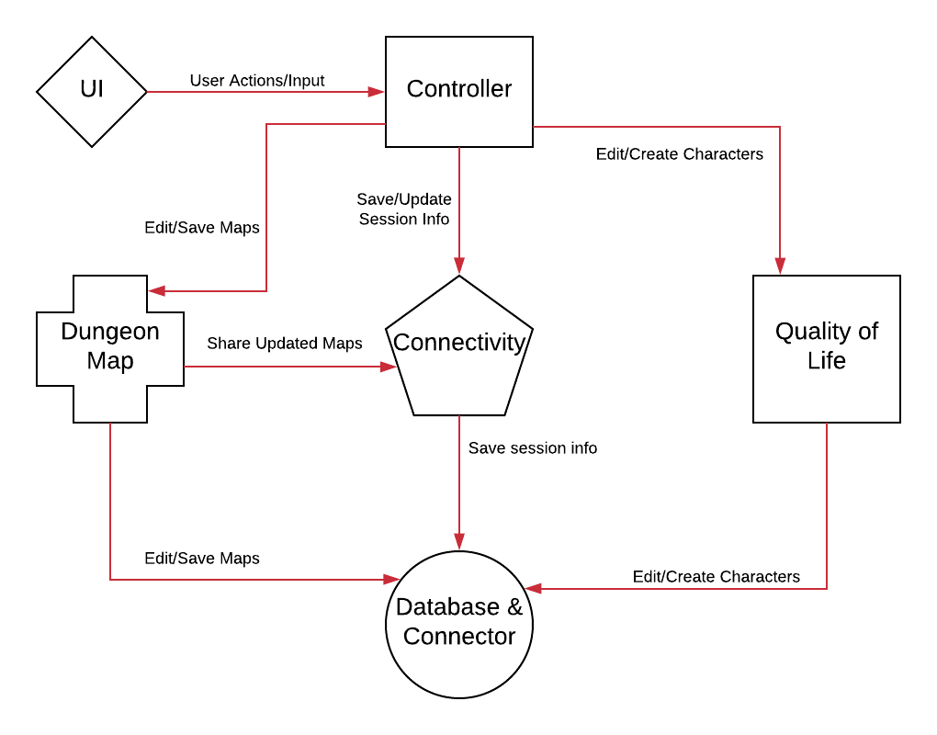
Subsystem Communication
Outputs

Slide 14
Algorithm Analysis
O(n)
Insert to table with unique fields
Update
Select
Delete
O(log(n))
Insert to table with unique fields and indexes
Update with indexes
Select with indexes
Delete with indexes
O(1)
Insert to table without unique fields
Establishing connection to DB

